Slide 1
Resources for De-Implementing Pre-Op Testing for Low-Risk Surgeries

Slide 2
ROADMAP FOR ADDRESSING UNNECESSARY PRE-OP TESTING AT YOUR HOSPITAL
Find a champion (or 3, or 10)
Review available baseline data
Discuss the topic with different stakeholders & identify issues that drive testing
Gather more focused data to help you understand the problem
Develop resources, decision aids, and strategies to address issues at your local site
Maintain stakeholder engagement & data collection
Kick-off engagement with targeted clinicians
How do I get started?
How do we reach goal of reducing low-value testing?
CHAMPION
MVC PRE-OP TESTING REPORT
SURGEONS, ANESTHESIA, PRE-OP CLINIC STAFF
CHART REVIEW OF 100 CASES
TESTING TOOLS, EDUCATIONAL MATERIALS, & WEBSITE DEVELOPMENT
ONGOING COMMUNICATION & INFORMATION SHARING
SURGERY DIVISION MEETING PRESENTATIONS

Slide 3
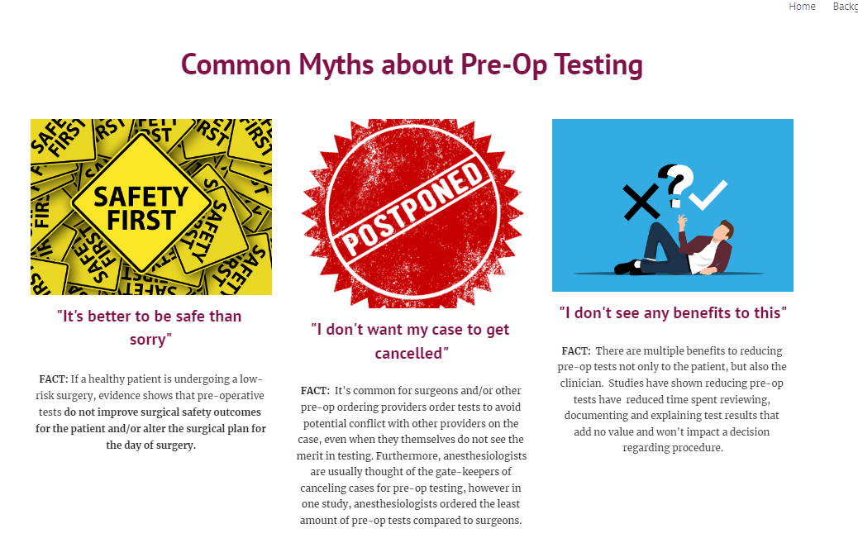
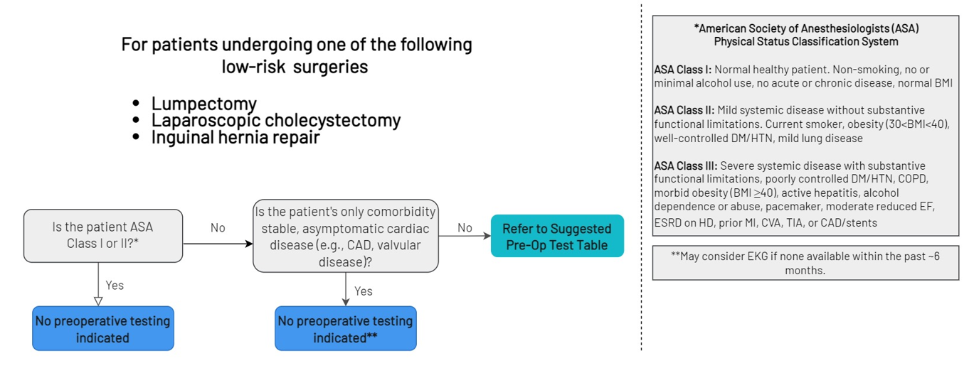
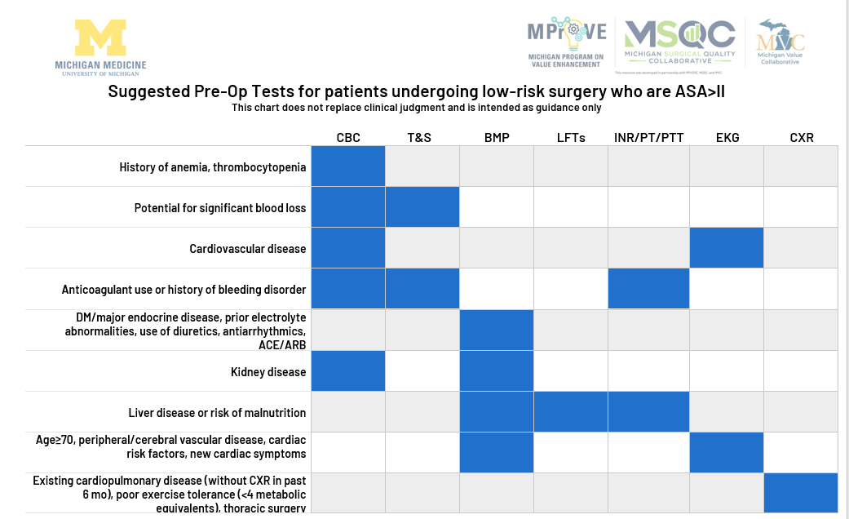
Resources:
Decision Aids
Guidelines
Website
Sources
Compilation of national guidelines from academic societies + Choosing Wisely

Slide 4
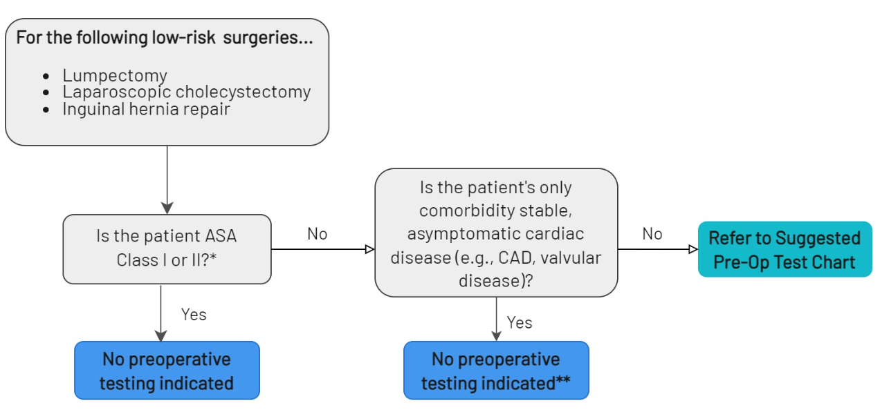
Pre-Op Testing Decision Aid for Low-Risk Surgeries
Notes:
**based on national guidelines/med society recommendations/existing research →Consolidated by MPrOVE,
Welcome to use as is and also ***We encourage you to bring this back to your surgical/anesthesia depts to verify by your institution & adapt as your institution sees fit
Leadership from our collaboration (Lesly, Dr. Hari Nathan, Dr. Englesbe)

Slide 5
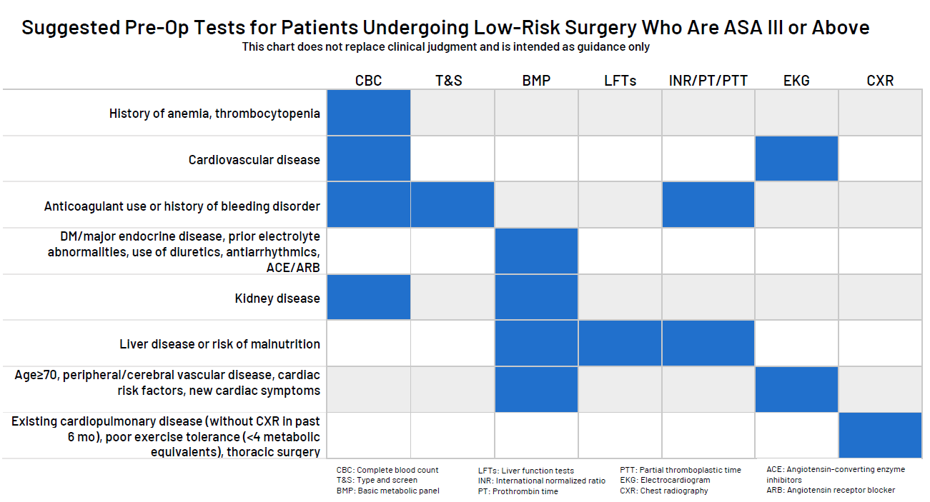
Notes:
Can adapt locally to add/subtract tests to add to your pre-op testing panel

Slide 6
Customizable Templates

Slide 7
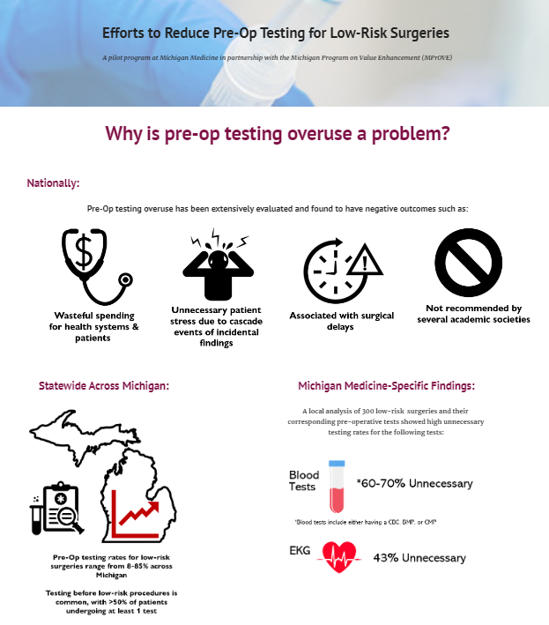
COMING SOON: Pre-Op Testing Website
Target Audience:
All MSQC Participating Hospitals
Anyone involved in Pre-Op Testing
Anyone who wants to learn more
Features:
Background information
Common Myths of Pre-Op Testing
Decision Aid
Case Scenarios
Notes:
*after, ask about “what else do you need?” 3xt5 card, etc…

Slide 8
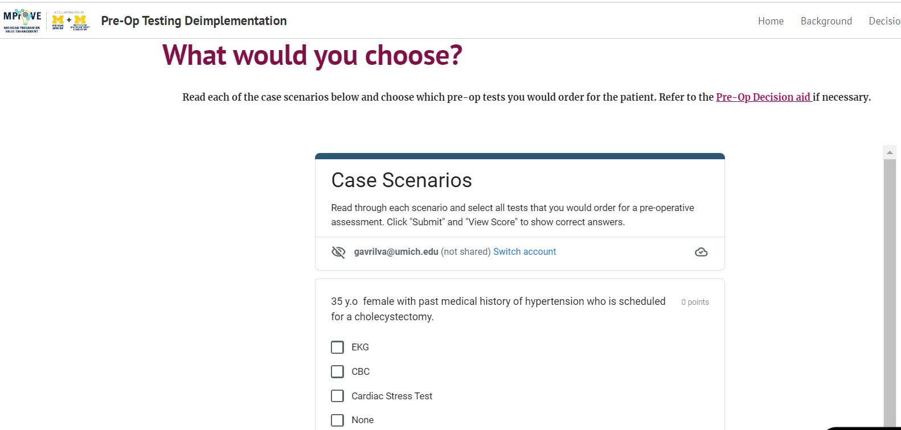
Website Features

Slide 9
Questions?

Slide 10
Notes:
ASA Class

