Slide 1
Quality Improvement Initiative
Frailty
2024

Slide 2
What is Frailty?
NOT the same as aging, but more common with increasing age
A deterioration of physical reserves resulting from stressors accumulated over time

Slide 3
Why Screen for Frailty?
The presence of frailty increases the risk of:
Mortality
Complications
Non home discharge in those who could previously live independently
Screening for frailty is the only intervention shown to consistently improve outcomes in these patients

Slide 4
Goals of the Frailty Project
Determine frequency of encountering frail patients in the general surgical population using approved screening tools
Initiate informed discussion between surgeon and patient/caregivers regarding risks specific to this population
Lower the incidence of morbidity and mortality for frail patients undergoing elective procedures

Slide 5
Implementation

Slide 6
Requirement 1: Multidisciplinary Meetings
Hold a total of 3 meetings throughout the course of the year with your stakeholders
Stakeholders should include people from various departments who will participate in the implementation of the project
First meeting must take place by 3/29/2024 with two additional meetings prior to 12/31/2024
First meeting to discuss project requirements/plan for implementation
Subsequent meetings to discuss progress, identify and troubleshoot barriers to implementation
Attendees and agenda/minutes to be included in final project submission

Slide 7
Requirement 2: Determine Frailty Screening Tool
For returning sites
If continuing with 2023 tool, no action needed
If changing tools, please notify the Coordinating Center prior to 3/29/2024
For new sites
Choose from available screening tools in Frailty Toolkit
Notify Coordinating Center prior to 3/29/2024 of choice of tool

Slide 8
Requirement 3: Use of Frailty tool in > 75% of eligible patients
Age > 60 years on day of surgery
Current dialysis
Current cancer
Functional Health Status “Not Independent”
Current CHF

Slide 9
New in 2024
Determine rationale for qualified patients not screened for frailty
This is not tracked in P4P
Purpose is to identify barriers to screening so that solutions can be identified
Communication/logs kept by office staff are acceptable to obtain this information

Slide 10
Requirement 4: The conversation
Only required for patients who screen Frail or Pre-frail
Attestation required in the chart of frailty screening score, goals and surgical plan
Goal > 75% of eligible patients
An informed decision-making process/discussion between surgeon and patient is the only intervention consistently recognized as having a positive impact on outcomes of Frail patients!

Slide 11
Requirement 6: Goals of the patient
The overarching goals of the patient should be documented in > 75% of patients who screen as frail/pre-frail
Goals should be broader than the specific aim of the surgery
Purpose is to have the life goals of the patient identified so they can be used to guide decision making throughout the surgical encounter
Tool for guiding shared decision making shown to improve outcomes

Slide 12
Preoperative Education
Frailty specific education-what is frailty and how does it impact surgery
Suggestions for mitigating risk that can reference general surgery education materials if appropriate
Can be done by RN, APRN or PA
Must be verbal and in writing
May periodically confirm standard practice with office to meet measure

Slide 13
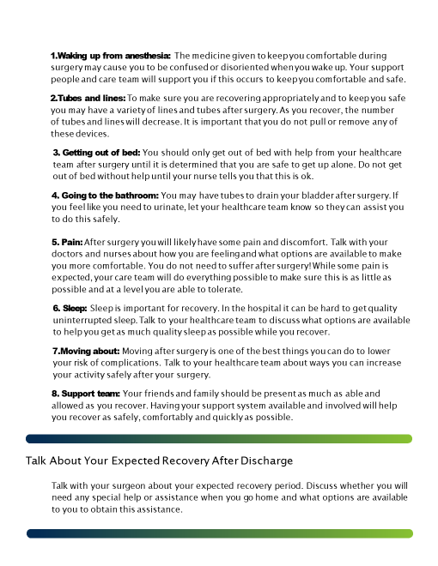
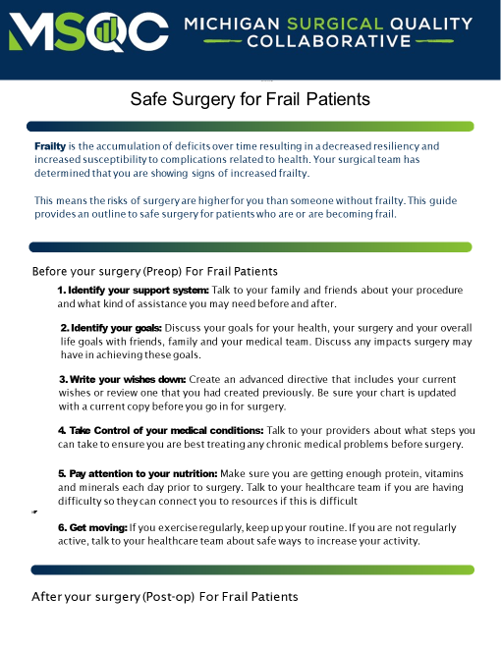

Slide 14
Questions and Comments

